Slide 1

LDS – Laser Detect Systems
Advanced Raman Spectroscopy

Slide 2

The things we are about to learn:
1
The detection process.
2
How to create a good Raman graph.
3
Good and bad Raman graphs.

Slide 3


THE DETECTION PROCESS
Engagement
01
A laser source illuminates a spot on the surface being scanned. Any narcotics residue present mixed inside the substance Raman scattering.

Slide 4

THE DETECTION PROCESS
Analysis
02
The scattered light is collected by a telescope and analyzed by a spectrometer and detector. A spectral fingerprint (i.e., the Raman spectrum) is generated.

Slide 5
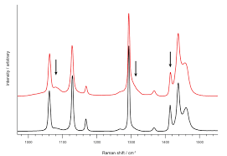
THE DETECTION PROCESS
Outcome
03
The spectrum is compared with previously recorded Raman signatures of various narcotics, and a match alerts the operator to the probable presence of hazardous substances residue.

Slide 6
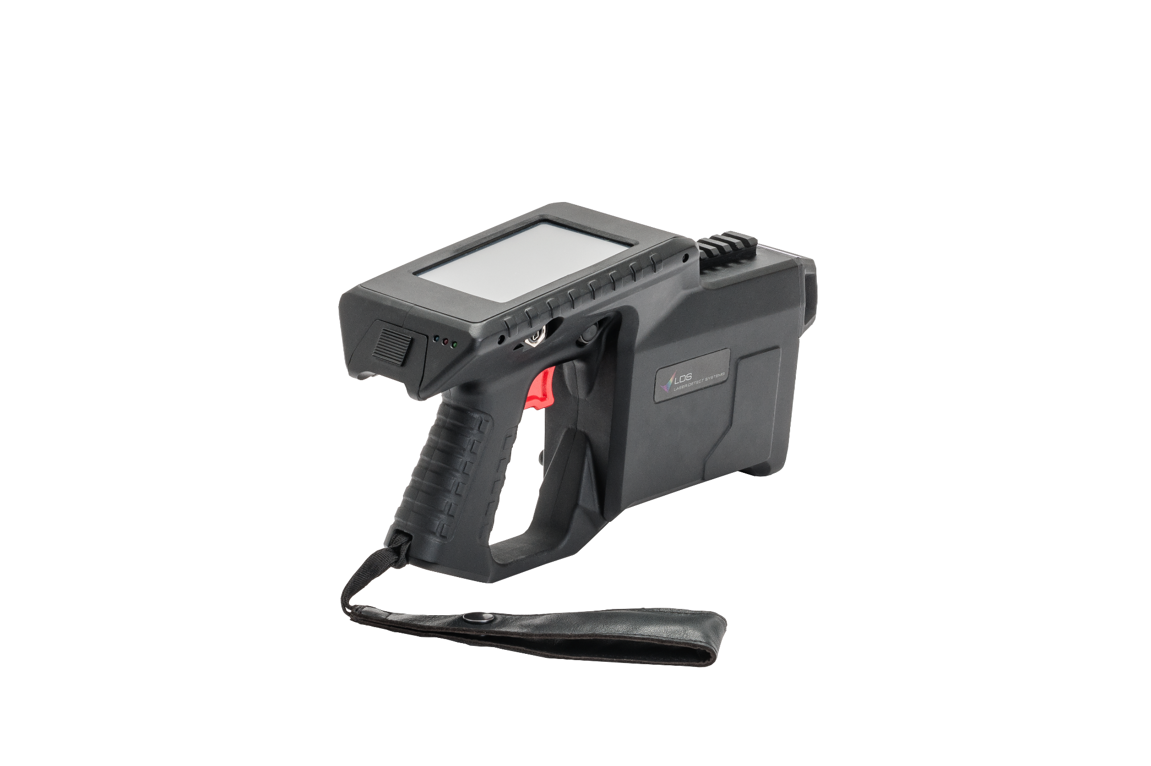
The Raman Spectroscopy- how it works
532 nm
Professional level
_____ nm
How the graph
Is created:

Slide 7
The Raman Spectroscopy- Examples
TNT
COCAINE
C4
UN

Slide 8
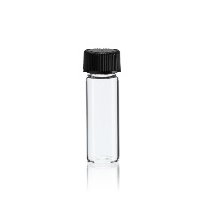
How to create a good Raman graph
The best Raman spectra will be taken out using the orange tip- vial mode.
The orange tip provides the best environmental conditions for the device.

Slide 9
How to create a good Raman graph
Fill the vial with enough quantity of the tested material- as mentioned in the picture.

Slide 10
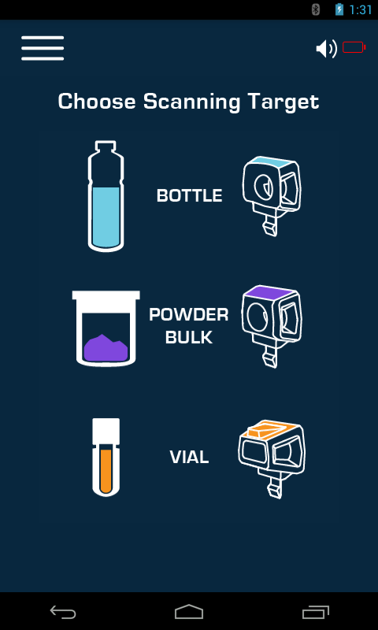
Creating the graph- screens
Choose the Vial mode

Slide 11
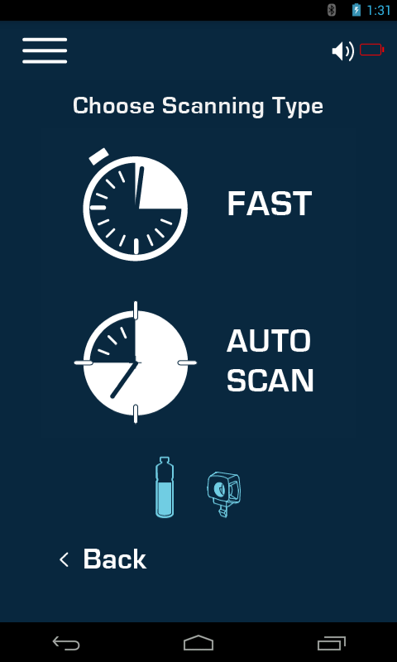
Creating the graph- screens
Graphs that we wish to insert will always be taken on AUTO SCAN mode.

Slide 12
Creating the graph- screens
Pull the trigger

Slide 13
Creating the graph- screens
Press “Save Data”

Slide 14
Creating the graph- screens
Fill all the fields and press “save”.
Then press the menu button:

Slide 15
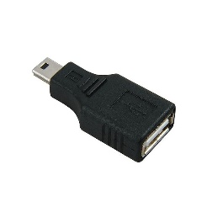
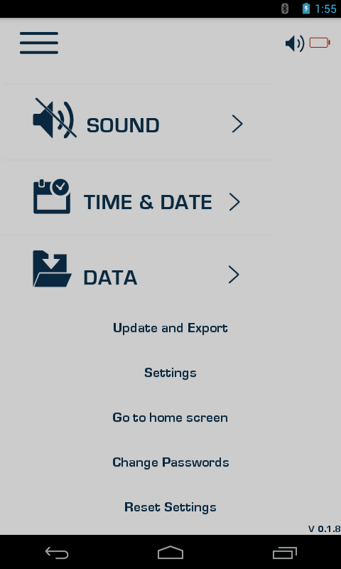
Creating the graph- screens
Press update and export.
Plug in the mini USB adapter together with USB component.
Roll the page down and press export spectrums.

Slide 16
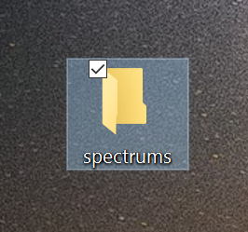
Creating the graph- screens
A new folder name “spectrums” is automatically created on your USB.
Plug it into the computer and send it via E-mail.

Slide 17
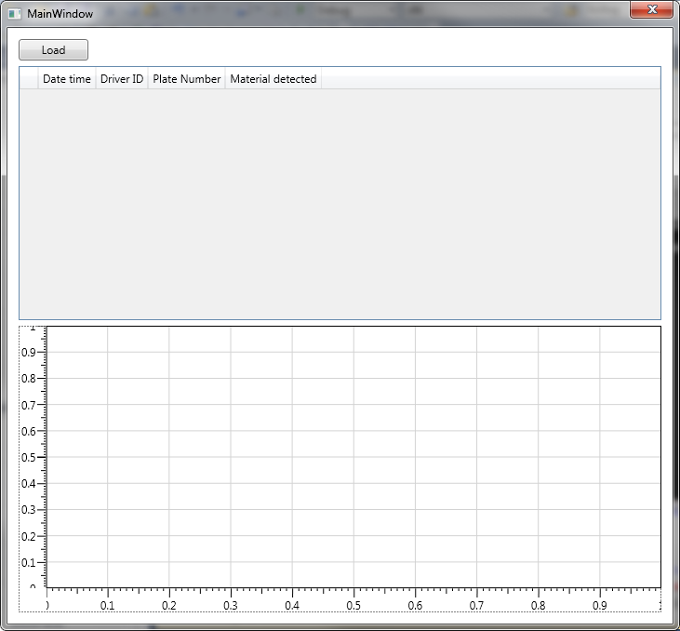

Slide 18
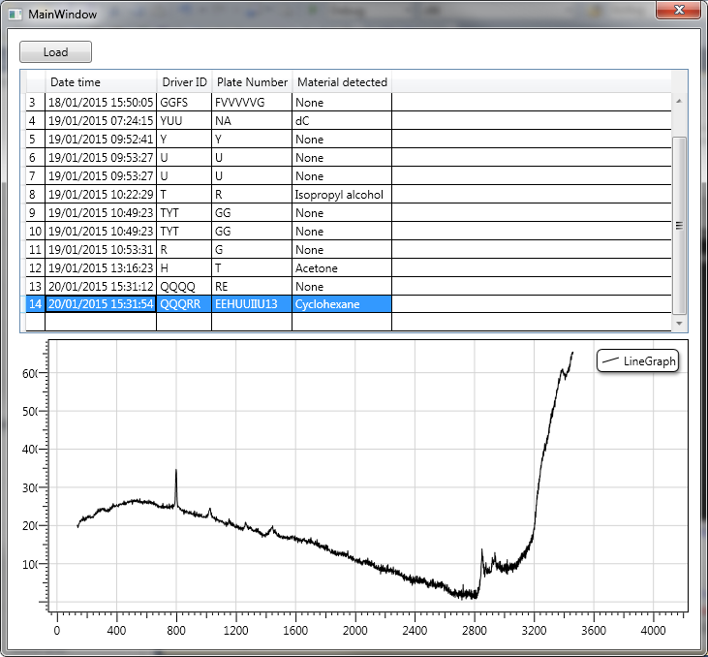

Slide 19
Quality of Raman graphs

Slide 20
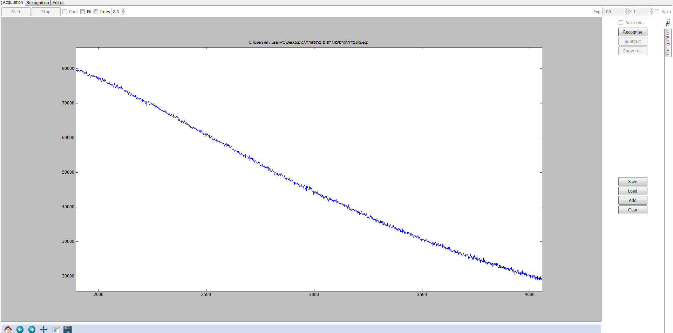

Slide 21
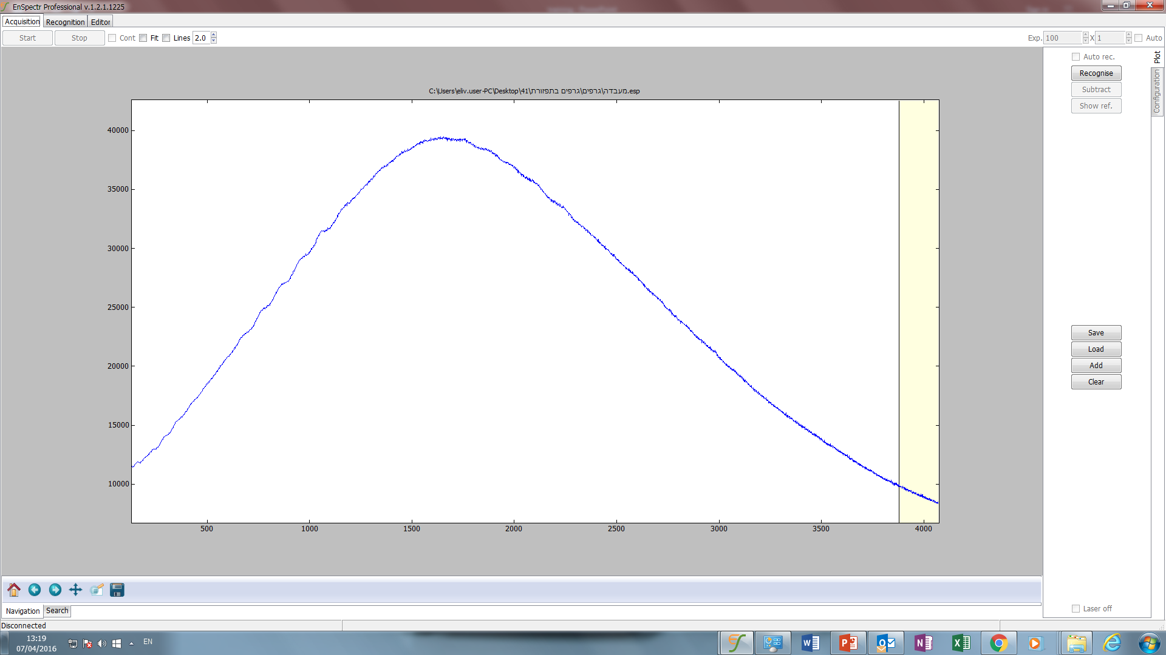

Slide 22
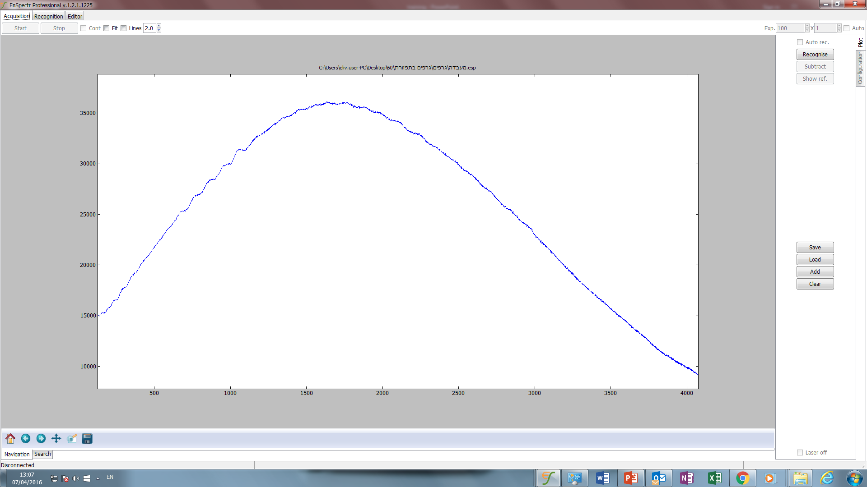

Slide 23
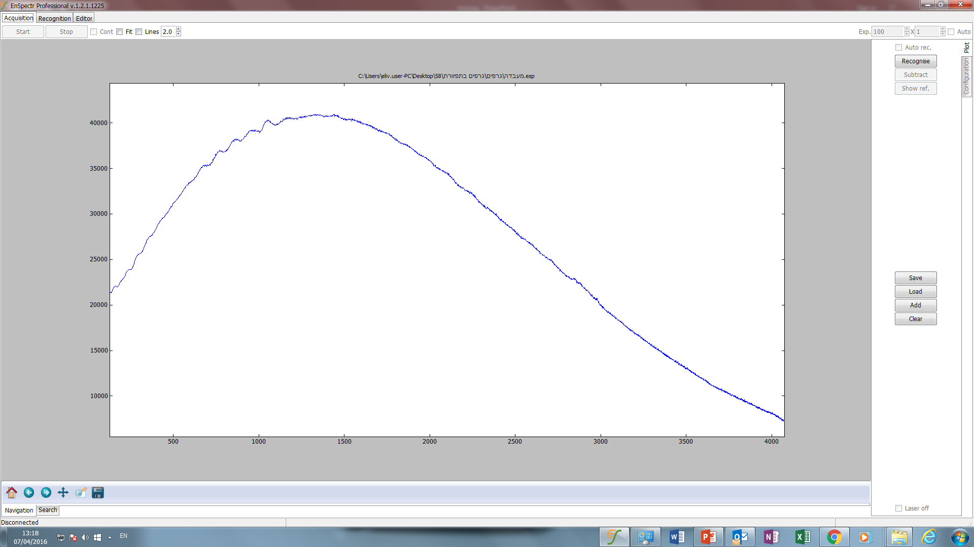

Slide 24
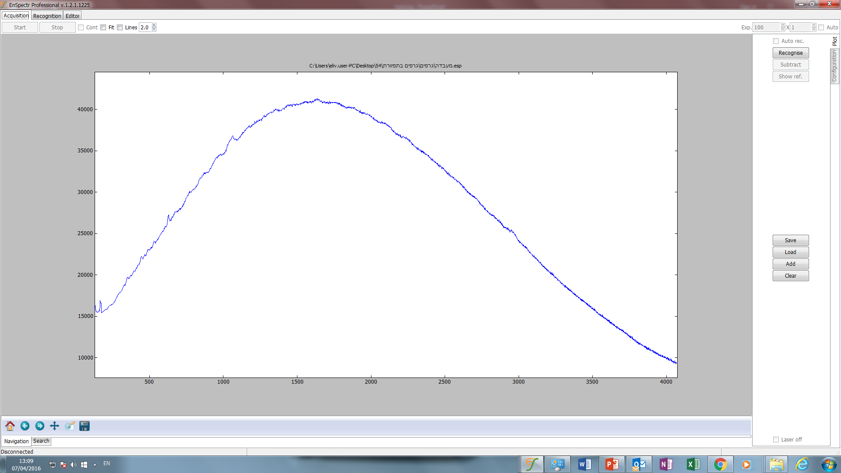

Slide 25
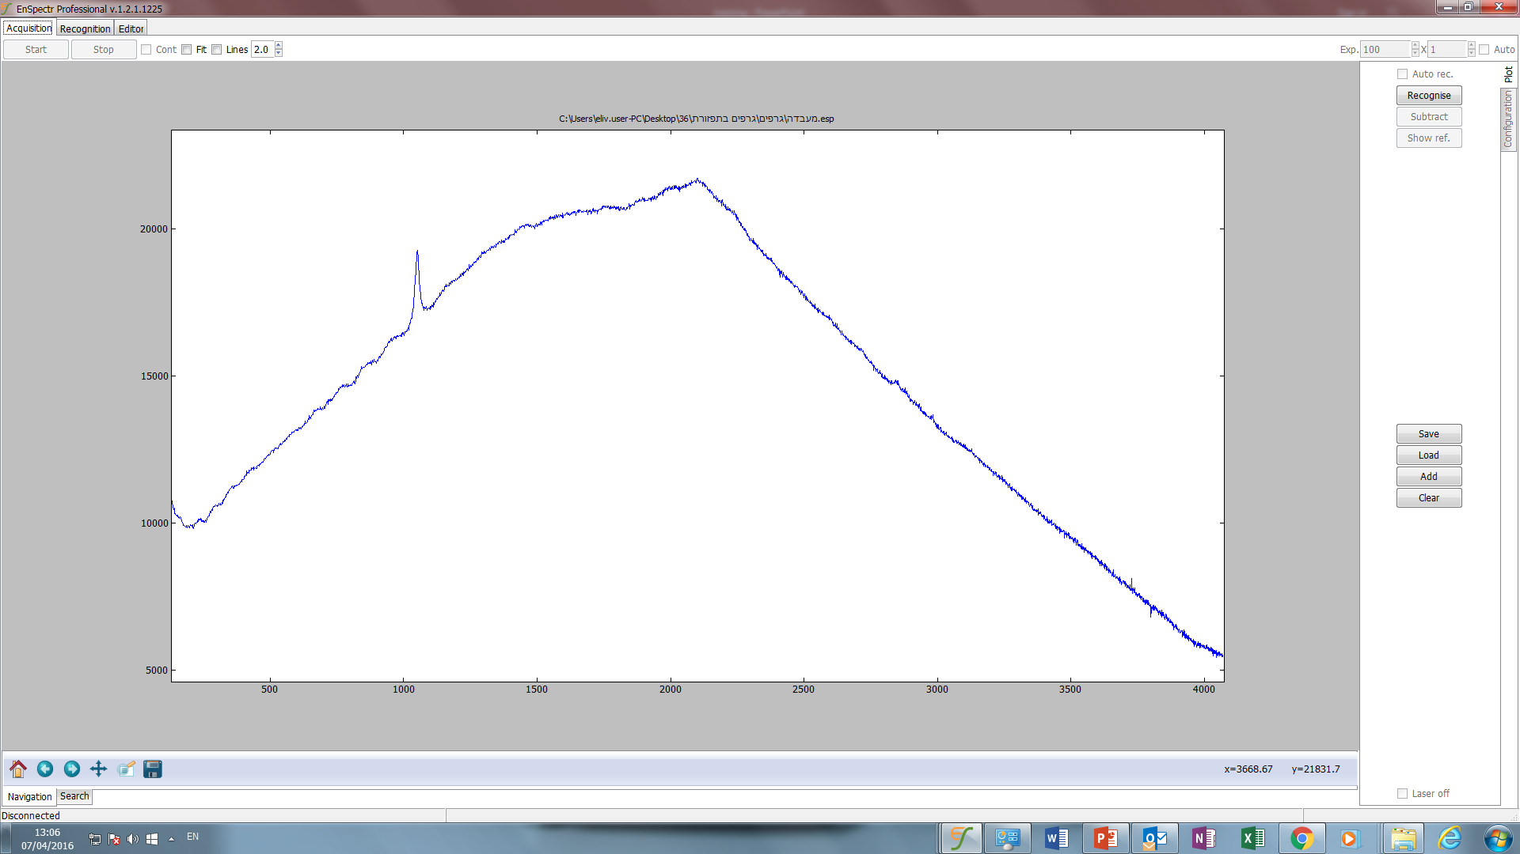

Slide 26
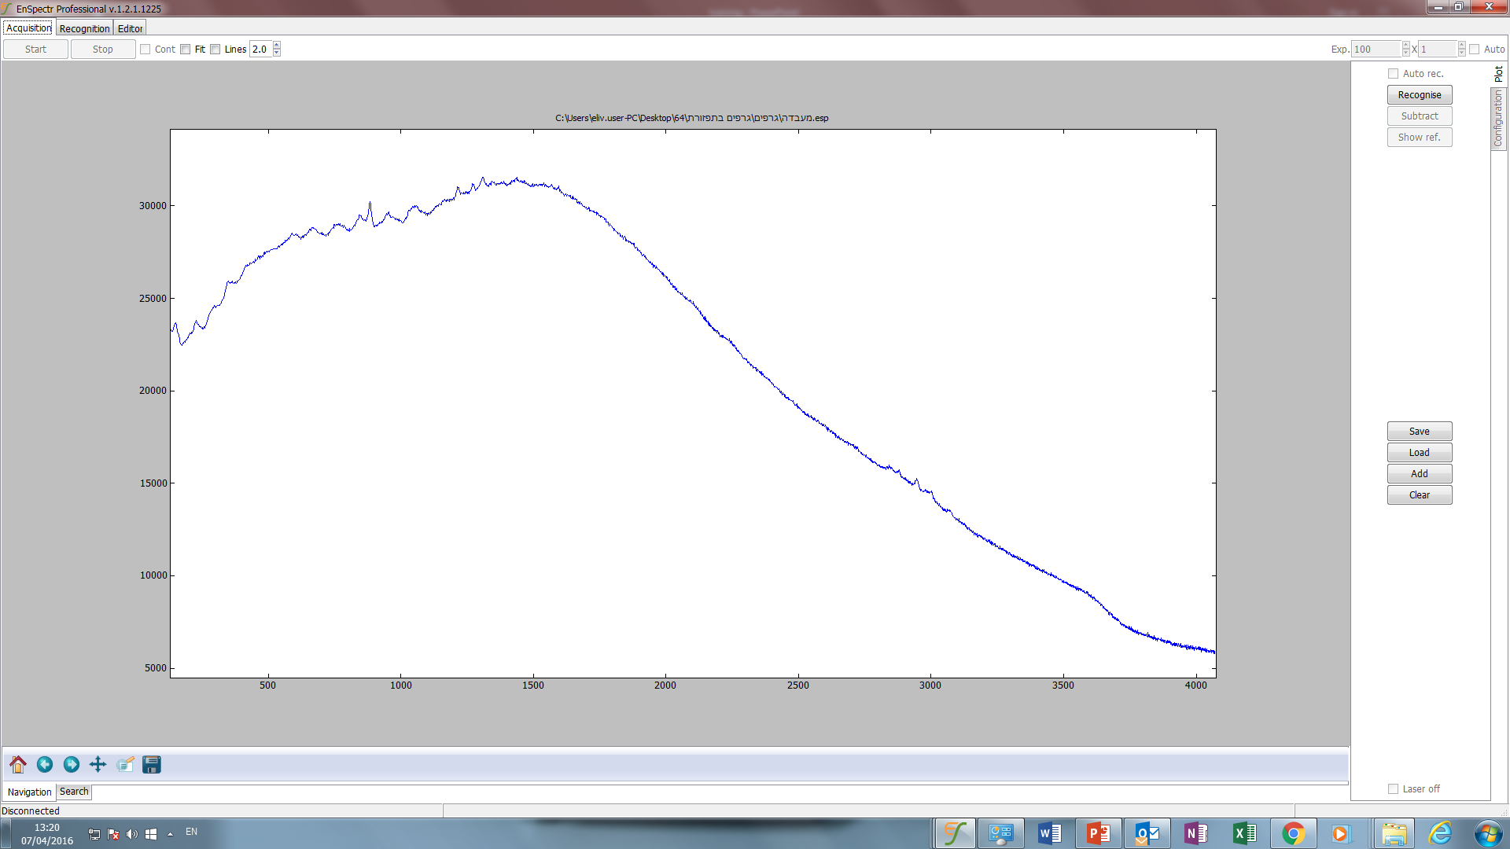

Slide 27
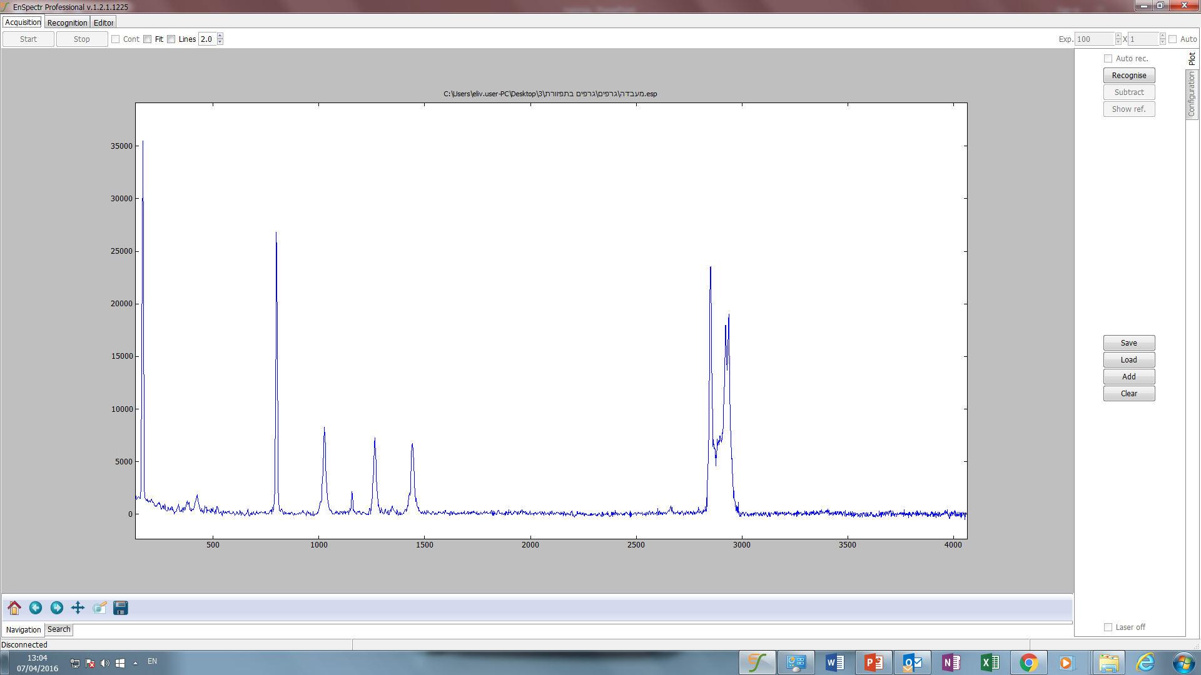

Slide 28
Questions

Slide 29

THANK YOU

